Slide 1
Instant Radiosity

Slide 2
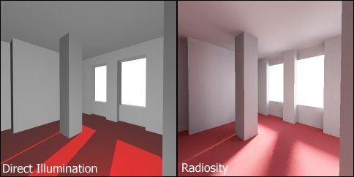
Instant Radiosity Introduction
The two pictures on the right rendered by direct illumination and Radiosity respectively. The picture using Radiosity shows more realistic, the shadow looks more soft and light distributed more evenly.
Instant Radiostiy is a global illumination algorithm in the sense that the illumination arriving at the eye comes not just the light sources, but all the scene surfaces interacting with each other as well. This algorithm has many advantages, for example, easy implementation, converge fast than other global illumination algorithm, low discrepancy and viewpoint independent. And scholar Alxendar Keller’s gave an elegant approach to compute instant radiosity.

Slide 3
1. One slide backgroud
2. One slide raytracer
3. One slide for instant radiosity
4. 3-5 pictures with small description
5. Future work.

Slide 4
1. One slide backgroud
2. One slide raytracer
3. One slide for instant radiosity
4. 3-5 pictures with small description
5. Future work.

Slide 5
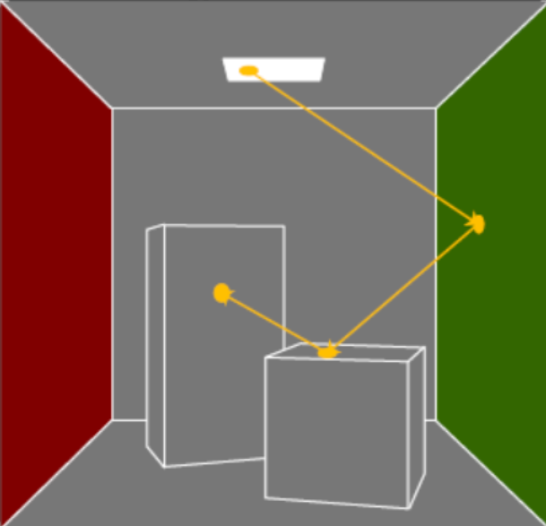
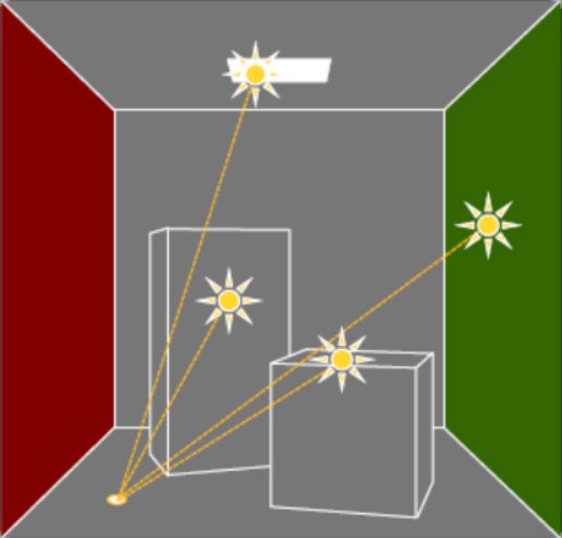
Instant Radiosity Algotihm
Step 1:
(1). Sample the light source and direction;
(2). For each vpl on the path, we first store this vpls’s power and position and then sample its direction using halton sequence and keep tracing
Step 2:
(1). Calculate each intersection point’s radiance by accumulating the contribution from all vpls.
(2). Output the image

Slide 6
Future work
1. Find a correct approach to accumulate each point’s radiance.
2. Add shadow, reflection and refraction.
3. Parallel this method to try to run it in real-time
4. Improving sample strategy.

